Slide 1
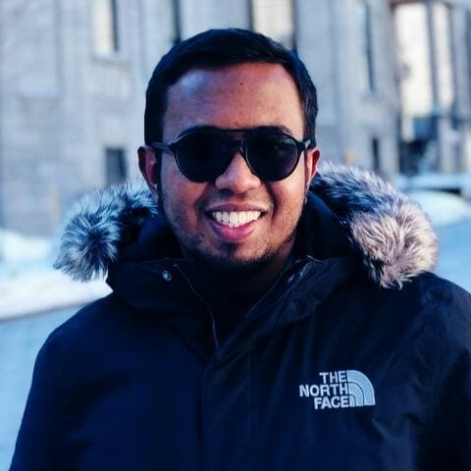

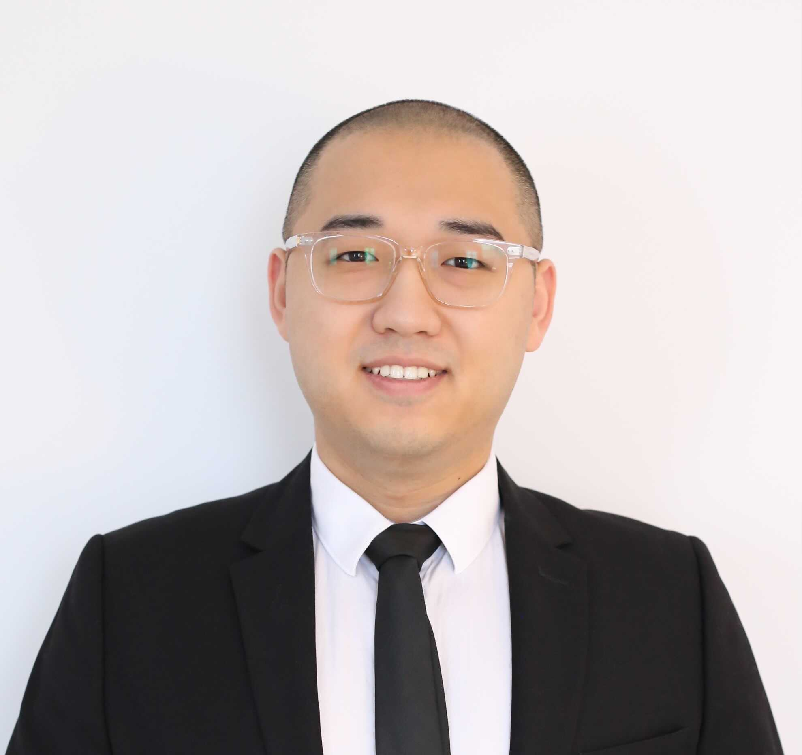
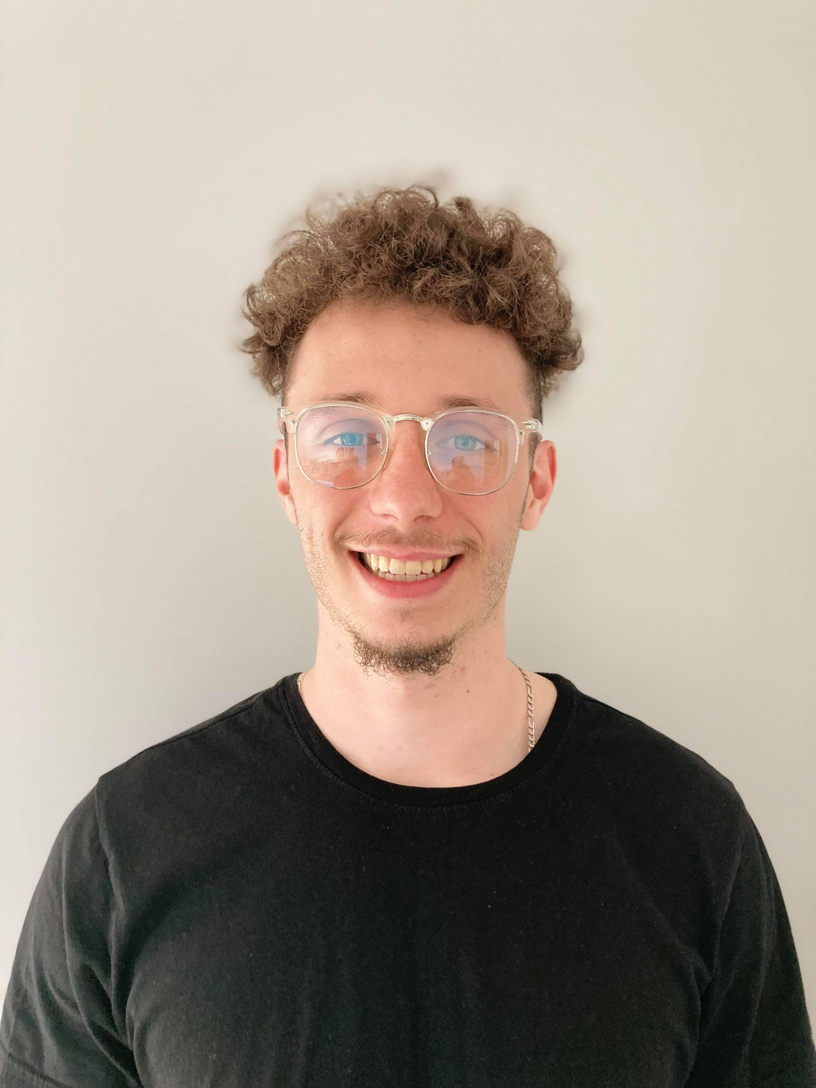
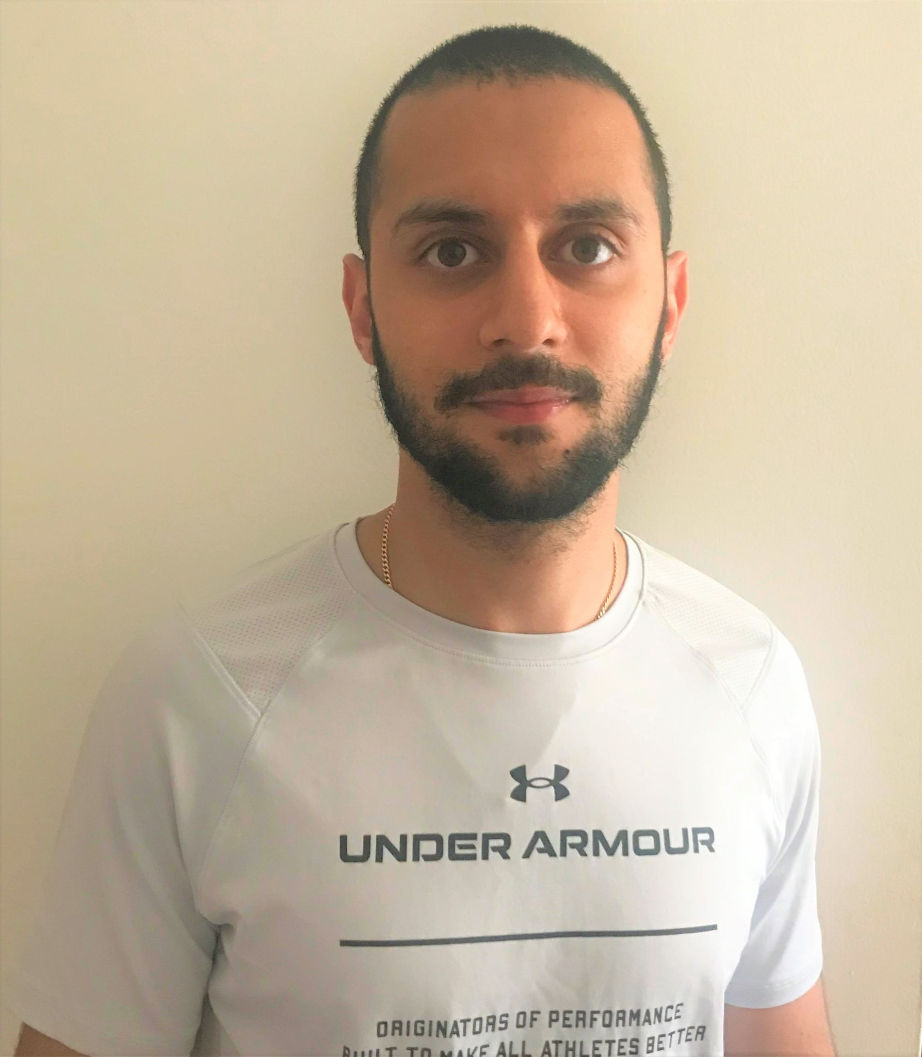
AI FOR TRADING SYSTEM
Sihab Uddin
Zixin Wang
Wentao Ju
Frédéric Pelletier
Nazim Benguettat

Slide 2
Synthesis

